Slide 1

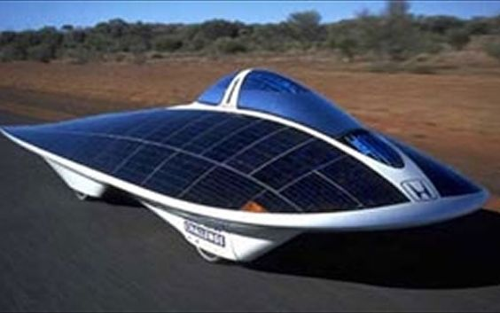
SOLAR CAR
BHUVAN NAWARIA 2021MEB1276
GURSIMER SINGH 2021MEB1285
HARSHDEEP DEY 2021MEB1286
HARSHVARDHAN SINGH 2021MEB1287
DEEPAK SONI 2021MEB1279
KORUPOLU DEEKSHITA 2021MEB1292
KAYATHA SARAN YADAV 2021MEB1290

Slide 2
AIM :- Solar car
Objectives :-
1.To make a power efficient car.
2.To make a cost friendly by using less cost products.
3.Car should use solar power as primary source of power.

Slide 3
Materials Used:- (To make prototype)
1.Motors 4v – 4 piece
2.Solar panel 6v -2 pieces
3.Battery rechargeable – 2 pieces
4.Wheel – 2 inch – 4 piece
5.Motor driver
6.Uno chip board
7.Bluetooth module
8.Battery module
9.Soldering Iron
10.Stationary products

Slide 4
Method :-
Connecting motors with the motor driver.
Installed the UNO chip and connected it with the motor driver.
Installing the Bluetooth module and connecting it to the UNO chip.
Installing the solar panels.
Rest all the connections and components is shown in the figure on next page.

Slide 5
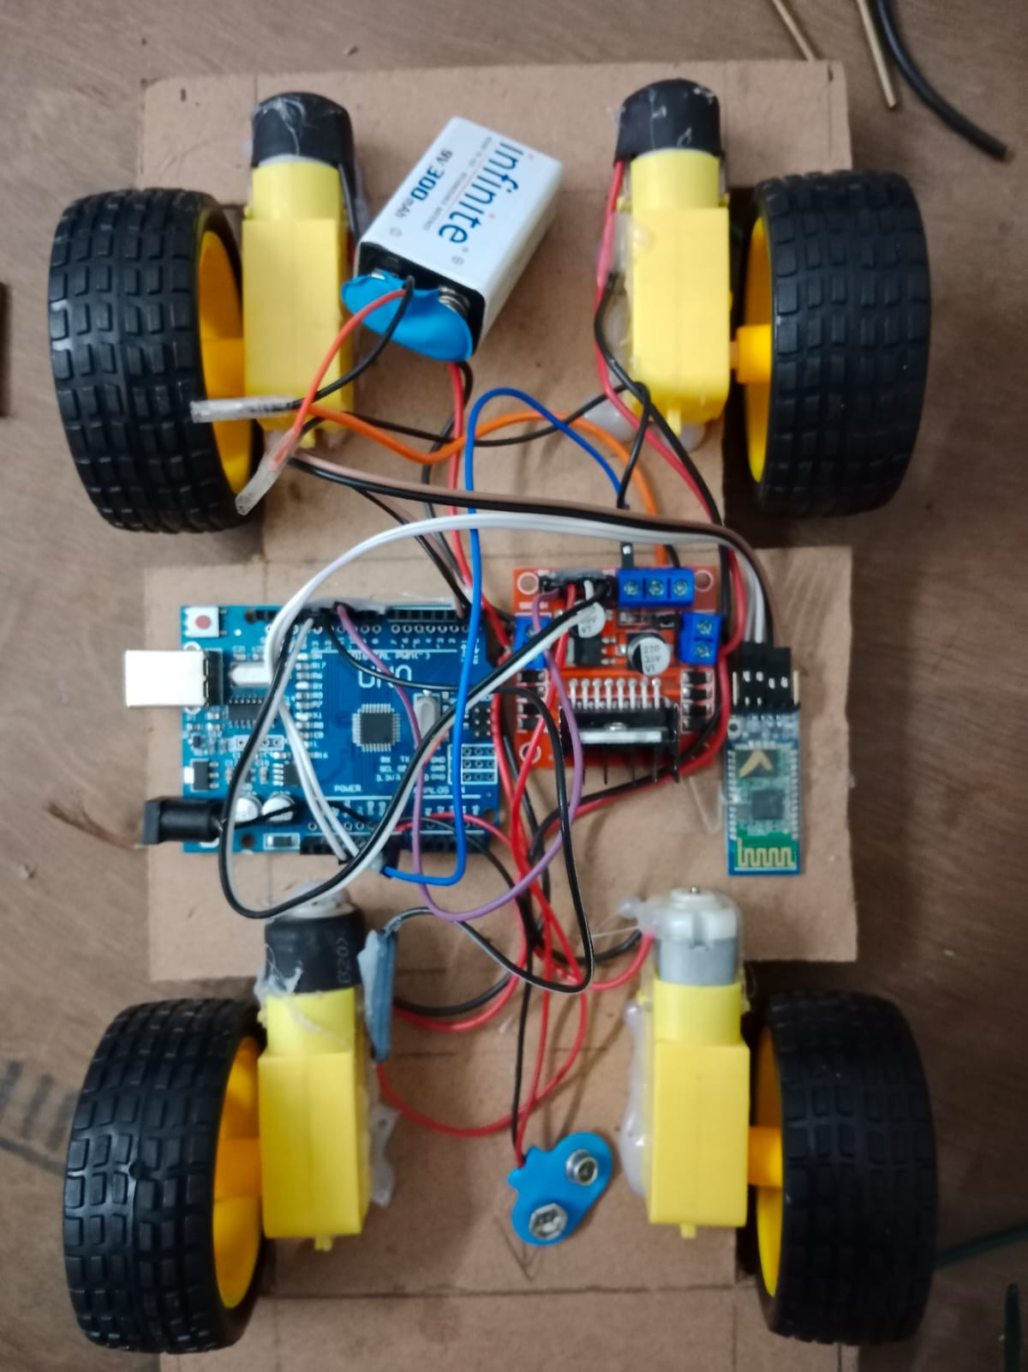
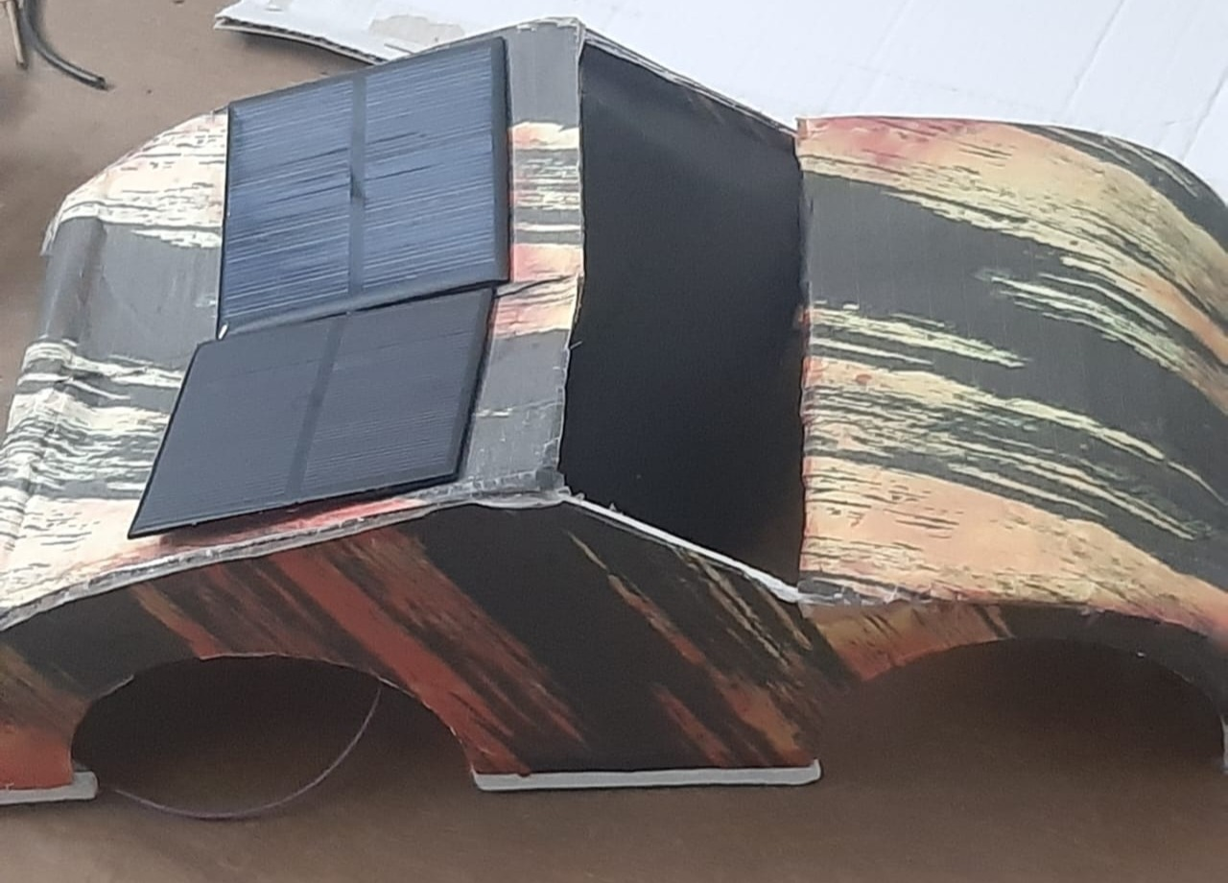
Prototype :-

Slide 6
Advantages and disadvantages
No Emissions. Because solar-powered cars have electric motors, they burn no fuel and produce no emissions.
preservation Of Natural Resources.
No Fuel Costs.
Driving Comfort and eco-friendly.
Financial benefit.
Disadvantages:
Less power
Initial investment is quite high
Requires better way to store energy.

Slide 7
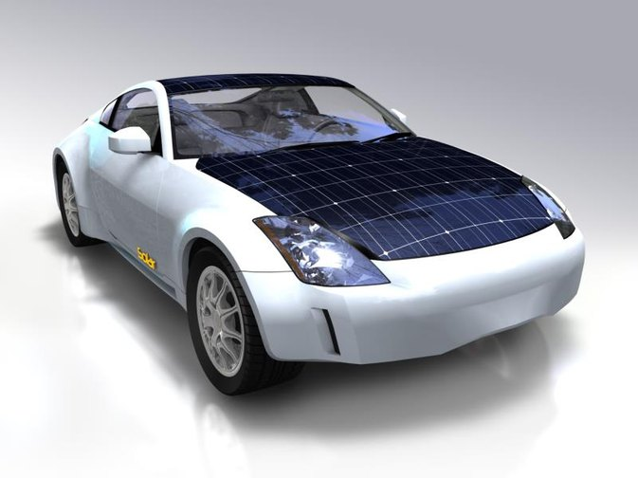
Conclusion:
Solar car would be an amazing advancement in the future car technology.
They would allow free and pollution less travel with unlimited accessibility.
If some minor drawbacks associated with solar car can be rectified , then for sure solar car will play a vital role in future transportation.

